Slide 2
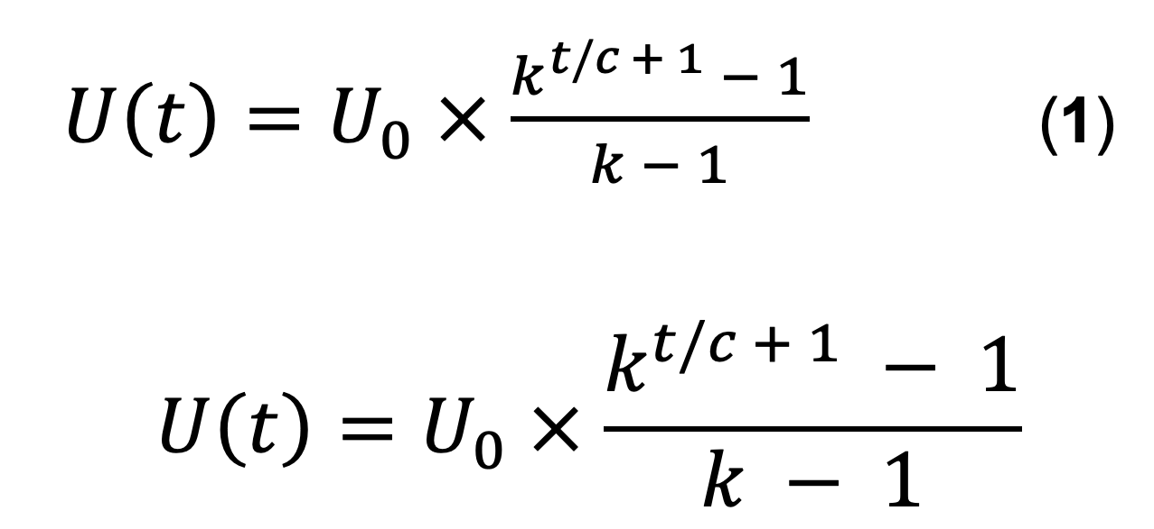

Slide 3
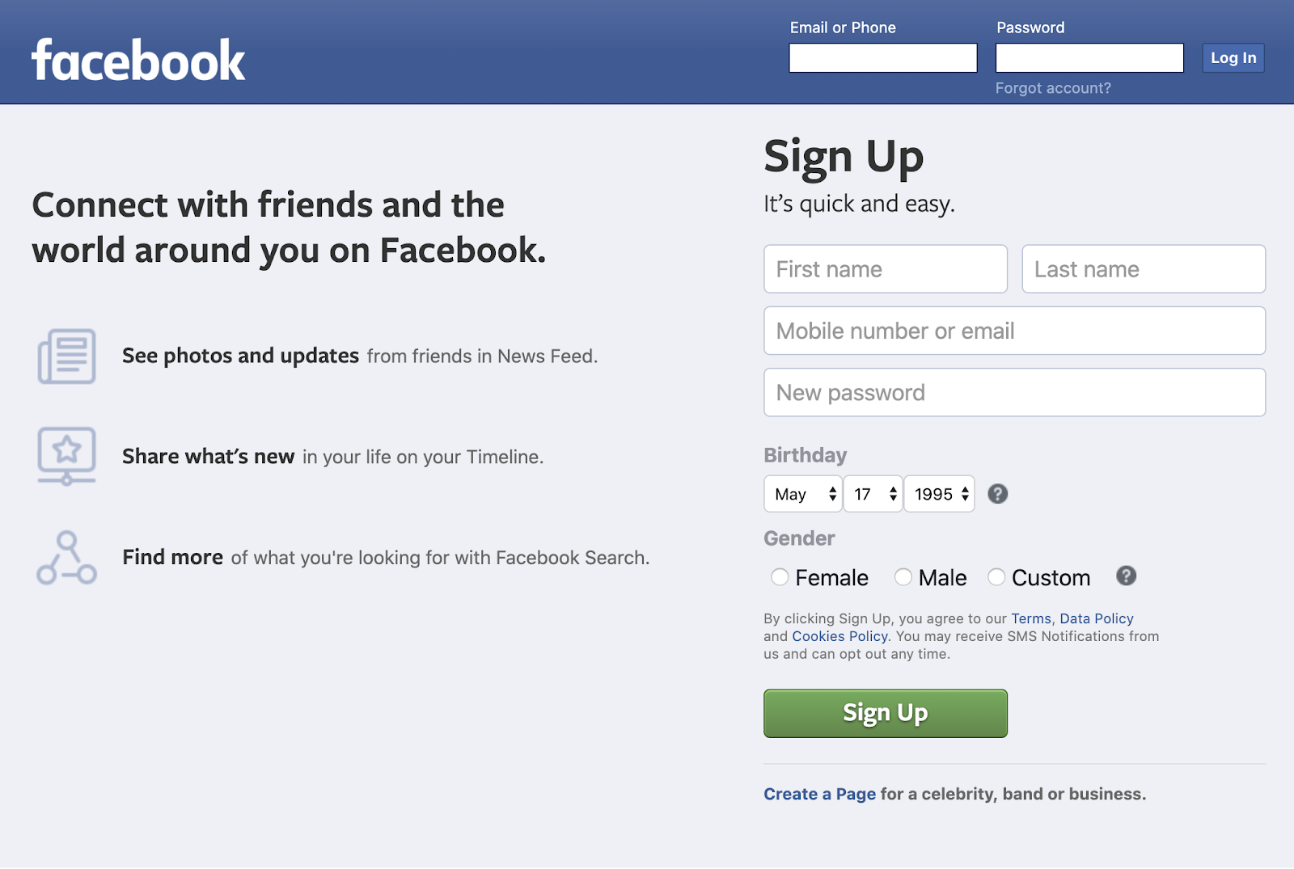
Maximize invitation rate
Current user sees
Two-way invite incentive
Pre-populated invite list
Minimal required input fields
Value proposition to new user
Invited new user sees
Maximize acceptance rate

Slide 4
(Non-users)
conversion
Cumulative registered users
retention
Active users
New users
churn (late)
resurrection
Lost users
churn (early)

